Slide 1

What is Quorum transaction?
1

Slide 2

Transaction
Transactions are the proposals that update the ledger.
Quorum transaction uses an extended model of the Ethereum Transaction Model.
Ledger evolvement happens while applying transactions.
Quorum Transaction is propagated to the rest of the network using the standard Ethereum P2P Protocol.
Types of transactions:
Private Transaction: Transactions whose payload is only visible to the authorized network
participants for that transaction.
Public Transaction: Transactions whose payload is visible to all participants of the same network.

Slide 3
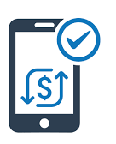
Public Transaction
Transaction Payload is visible to all participants of the same Quorum network.
Created as per the standard Ethereum Transactions.
Ethereum transaction supports three types of transactions:
Ether assignment from one party to another.
Creation of a smart contract.
Transacting with a smart contract.

Slide 4
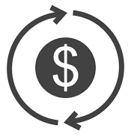
Private Transaction
Private transactions are facilitated through an API revealed to the Dapp that originates the transaction.
It has a 256-bit hash in the data field.
Not executed as per the Ethereum standard.
EVM does not support encryption or decryption operations.

Slide 5












How a Transaction is Committed?
Ethereum Protocol
Node A
Node B
TxPayload Request
TxPayload Request
Quorum Transaction
TxPayload Resp
TxPayload Resp
Quorum Transaction
Transaction Manager
Transaction Manager
TxPayload Store
TxPayload Store
TxPayload Store
API
API
DApp UI
DApp UI

Slide 6

Transaction Manager
Transaction Manager stores and enables access to encrypted transaction data, exchanges encrypted payloads with the transaction managers of other peers.
It is responsible for transaction privacy and managing local data stores.
It does not have access to any sensitive private keys.
It utilizes the enclave for cryptographic functionality.
Stateless in nature and it can be load balanced easily.

Slide 7
THANK YOU!

